Slide 1



WELCOME TO THE
WESTHEIGHTS PARK NATURAL AREA
COMMUNITY WORKSHOP #2
NOVEMBER 2024
HOW TO PARTICIPATE:
Explore the boards that outline the proposed actions that will shape the management plan
Participate in interactive activities
Connect with staff and project team members for questions
Share your feedback by completing a comment form

Slide 2



Project Overview
Community Workshop #1
The City of Kitchener is developing a plan for the ecological management, restoration, and stewardship of the Westheights Park Natural Area. This natural area is a key feature within the city that supports biodiversity and habitat for wildlife, while also contributing to the physical and mental wellbeing of the surrounding community.
The purpose of Community Workshop #1 was to:
Provide an update to the community on the natural environment assessment and findings to date
Educate the community about the principles of ecological restoration and natural area management
Gather input on the vision for the future of the area
Develop actions the City and community can take to restore and manage the area
The City, alongside Dillon Consulting and Dance Environmental, is facilitating workshops to engage the public in identifying opportunities for community involvement and input into the management and preservation of this ecologically significant space.
We Are Here!
Identify Management Needs and Action
Fall 2024
Vision and Key Directions
Continuing Ecological Studies
Spring 2024
Summer 2024

Slide 3


PLANT MANAGEMENT
WHAT WE HEARD
Introduction of more wildflowers and native plant species
Evergreens for winter birds
Clear back reeds and reduce weeds around the pond
Remove invasive species
Phragmites (Common Reed) Management
Reduce or eliminate the population of this invasive plant species since significant area of the ponds edge has been taken over by this invasive species.
Woodland Restoration
Identify native herbs, shrubs, and trees for plantings to improve biodiversity, benefit the wildlife and prevent erosion.
Remove non-native, invasive plants such as Garlic Mustard, Periwinkle and Common Buckthorn.
Remove BMX bicycle ramps, jumps, side trails; restore soils and vegetation.
MANAGEMENT OPTIONS DEVELOPED

Slide 4
PLANT MANAGEMENT
Review each management option and assign a priority level based on importance and urgency
Phragmites (Common Reed) Management
Woodland Restoration
COMMENTS
SECTION
PLACE DOTS UNDERNEATH MANAGEMENT OPTIONS
RED – HIGH BLUE – MEDIUM GREEN - LOW

Slide 5

WILDLIFE MANAGEMENT
WHAT WE HEARD
Maintain the pond’s natural state
Ensure the pond is healthy and consider making it deeper
Protect turtles and their nesting beach
Maintain a clean pond area supportive of all wildlife
MANAGEMENT OPTIONS DEVELOPED
Wood Duck Habitat
Install 1-2 wood duck nest boxes in the naturalized treed wetland area to the south of the main open water pond and monitor success.
Create Pollinator Areas
Identify specific locations and planting areas and plant a variety of native species tailored to site conditions to ensure optimal growth.
Turtle Nesting Habitat
Identify a location suitable for creating a sand nesting area to try and steer turtle nesting away from active paths where turtle nests may be destroyed. Nests could be screened for protection from predators.
Protect Chimney Crayfish Area
Protect Terrestrial Chimney Crayfish areas by avoiding use of heavy equipment and soil compaction in areas where they are present. Potential plantings may be introduced around the crayfish habitat to create a natural barrier and prevent disturbance.

Slide 6
WILDLIFE MANAGEMENT
Review each management option and assign a priority level based on importance and urgency
Turtle Nesting Habitat
Wood Duck Habitat
Protect Chimney Crayfish Area
Create Pollinator Areas
COMMENTS
SECTION
PLACE DOTS UNDERNEATH MANAGEMENT OPTIONS
RED – HIGH BLUE – MEDIUM GREEN - LOW

Slide 7
EDUCATION AND COMMUNITY INVOLVEMENT
WHAT WE HEARD
Install educational signs about types of trees and plants
Ensure the area remains natural and enjoyable for walking and appreciating nature
Encourage proper disposal of garbage through signage
Participate in planning meetings and arranging days for managing invasive species
Foster a sense of ownership and responsibility among residents through collective efforts
MANAGEMENT OPTIONS DEVELOPED
Signage at Key Areas
Create signage at the key areas where management actions are being taken.
Information about turtle nesting area, pollinator plantings etc.
Explain purposes of restoration or improvement
Spring and Fall Cleanup
Organize cleanup days during spring and fall at the park to remove litter, debris, and invasive plants.
Collect garbage throughout the park and work with City to have park waste picked up shortly after clean up day.

Slide 8
EDUCATION AND COMMUNITY INVOLVEMENT
Review each management option and assign a priority level based on importance and urgency
Signage at Key Areas
Spring and Fall Cleanup
COMMENTS
SECTION
PLACE DOTS UNDERNEATH MANAGEMENT OPTIONS
RED – HIGH BLUE – MEDIUM GREEN - LOW

Slide 9

ENHANCED
ACCESSIBILITY
WHAT WE HEARD
Improve accessibility for all
Install more benches for sitting
Create places to sit and watch the pond
WHAT CAN WE INCLUDE?
The City will consider this feedback as plans for the Natural Area advance. Do you have anything you’d like add to improve accessibility at Westheights Park Natural Area?
Leave your comments here!

Slide 10
WHAT ABOUT POND DREDGING?
The pond supports a vibrant ecosystem and diverse wildlife. Dredging it could lead to unintended harm, including the following impacts:
SO, WHAT CAN WE DO?
Environmental Damage
  Dredging necessitates entry of heavy machinery, causing damage and loss of vegetation around the pond's perimeter.
  Both terrestrial and pond edge vegetation will be significantly affected.
Long-Term Recovery
    If dredging occurs, the pond will take years to decades to recover.
    Returning to a diverse, functioning aquatic ecosystem will be a lengthy process.
Impact on Wildlife
    Pond inhabitants such as fish, turtles, and frogs will be killed or need temporary relocation when dredging.
    Relocation causes significant stress and poses survival risks.
Regulatory Approvals
  To dredge a naturally healthy ecosystem, regulatory approvals would be required from agencies such as the GRCA (Grand River Conservation Authority) and MNRF (Ministry of Natural Resources and Forestry).
  In contrast, approvals for stormwater management (SWM) engineered ponds are less stringent since these systems are designed for regular maintenance and interventions.
The City of will implement the Westheights Park Natural Area Restoration and Management Plan and continue to monitor and maintain the ecological health of the pond.
HERE’S HOW YOU CAN HELP!
Keep Westheights Park Natural Area Clean and Beautiful!
Join our efforts to maintain this cherished space.
Please dispose of trash responsibly—let’s keep the pond litter-free!
If you see littering or dumping, report it to help protect our natural environment.
Your support makes a difference!
Natural Area Designation
  Westheights Pond is a designated natural area.
  Dredging contradicts the purpose of this designation unless the area is in significant decline, which is not currently the case.
High Costs
  Dredging is an expensive process, requiring substantial financial resources.
  Additional costs will also incur as a result of relocating affected wildlife.
Ecosystem Disruption
    Draining water and removing soils disrupts the entire food chain.
    The functioning aquatic ecosystem will be negatively impacted.

Slide 11
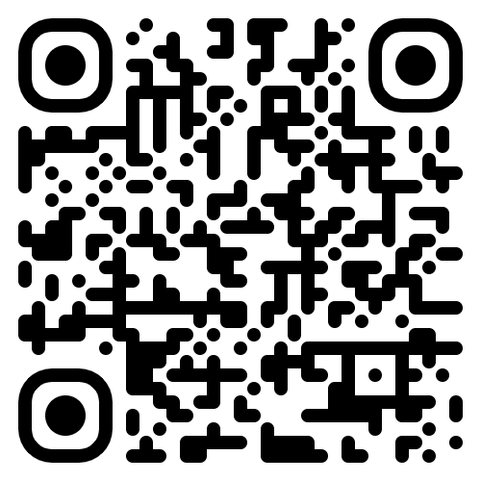
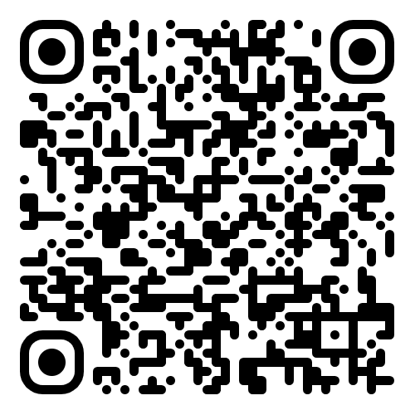

Monitoring Recommendations
Find Out More!
Monitoring both water conditions and invasive species over time is essential to detect changes that may negatively impact pond health. This proactive approach helps to preserve the pond’s natural state and ensuring it remains a safe, supportive environment for all wildlife.
View the project website for updates and explore ways to get involved!
Water Conditions
Regular monitoring of dissolved oxygen levels and key water quality parameters, such as phosphorus and coliform bacteria, is recommended.
Westheights Park Natural Area Restoration
iNaturalist Westheights Park Natural Area
Invasive Species
Monitor invasive species and document any changes over time, ensuring that no significant negative impacts or declines in pond conditions occur.
Send comments to:
Rachel Voros
Natural Area Project Manager
rachel.voros@kitchener.ca
  Josh Shea
  Forestry and Natural Areas Manager
  joshua.shea@kitchener.ca

